Slide 1

The root and branch role of knowledge brokers in supporting research impact
Notes:
Introduce self and background: UCL for 13 yrs; previously in industry media. Roles at UCL have all been knowledge mobiliser though not necessarily called that.
Today I’ll be talking about who KB are and the vital role they play as part of the research ecosystem (milking that tree metaphor)

Slide 2

What is cross-disciplinarity and why do it ?
A collaborative, systems-based approach to research that brings disciplines together to work holistically on a problem or challenge.
Breaks down silos between disciplines
Exposes researchers to different ways of thinking and working
Addresses complex and wicked challenges
But…
Terminology and understanding is still ill-defined
Barriers to grant funding and career progression remain
Perceptions of breadth v depth create tensions
This way of working is supported by a specialist skill set
Notes:
Very briefly as I think all here will be familiar but a quick recap on cross-disciplinarity
Its important to recap as this is the environment/type of research activity that KB roles are most often found or associated

Slide 3

Who does this need?
“Individuals undertaking knowledge mobilisation have a variety of professional backgrounds, including academic research, public affairs, policy, communications and wider knowledge exchange or impact roles.”
Often located in impact or knowledge exchange teams
Considered specialist generalists able to work across a wide variety of disciplines
Primarily found in PS teams but often with strong academic or other sector backgrounds and experience
Knowledge brokers’ work extends both into and beyond the university and could be considered a root and branch approach
Notes:
These support roles go by many titles, but they usually bring a specific set of skills that many of you will likely recognize in your own roles
Quote from recent CAPE report: Hidden Talents: Core Competencies of Knowledge Mobilisers Working in Public Policy
Link at end and highly recommend reading
looking at role within in Uni but often have similar counterparts in policy, industry or third sector organisations
So what types of skills to KBs have…

Slide 4

Notes:
Lets look at some of the critical skills of knowledge brokers in more detail. Today I’m picking out some of the highlights but there are many more

Slide 5





Build researcher capacity
Provide project
management
Contribute to strategic
academic activity
Evaluate to improve
processes
Align research to
external needs
Notes:
First those that support activity within the institution, the roots
-build researcher capacity
-contribute to academic activities
-align researchers with external need
-evaluate outcomes to improve process
-support project management

Slide 7





Broker
interactions
Build networks
and community
Undertake knowledge
synthesis
Champion research
Deliver outputs
Notes:
But KB roles are also very much outward facing branching out create and sustain external partnerships and impact
Champion research and contribute to culture
Facilitate/broker interactions
Build their own networks
Undertake knowledge synthesis
Deliver outputs

Slide 8

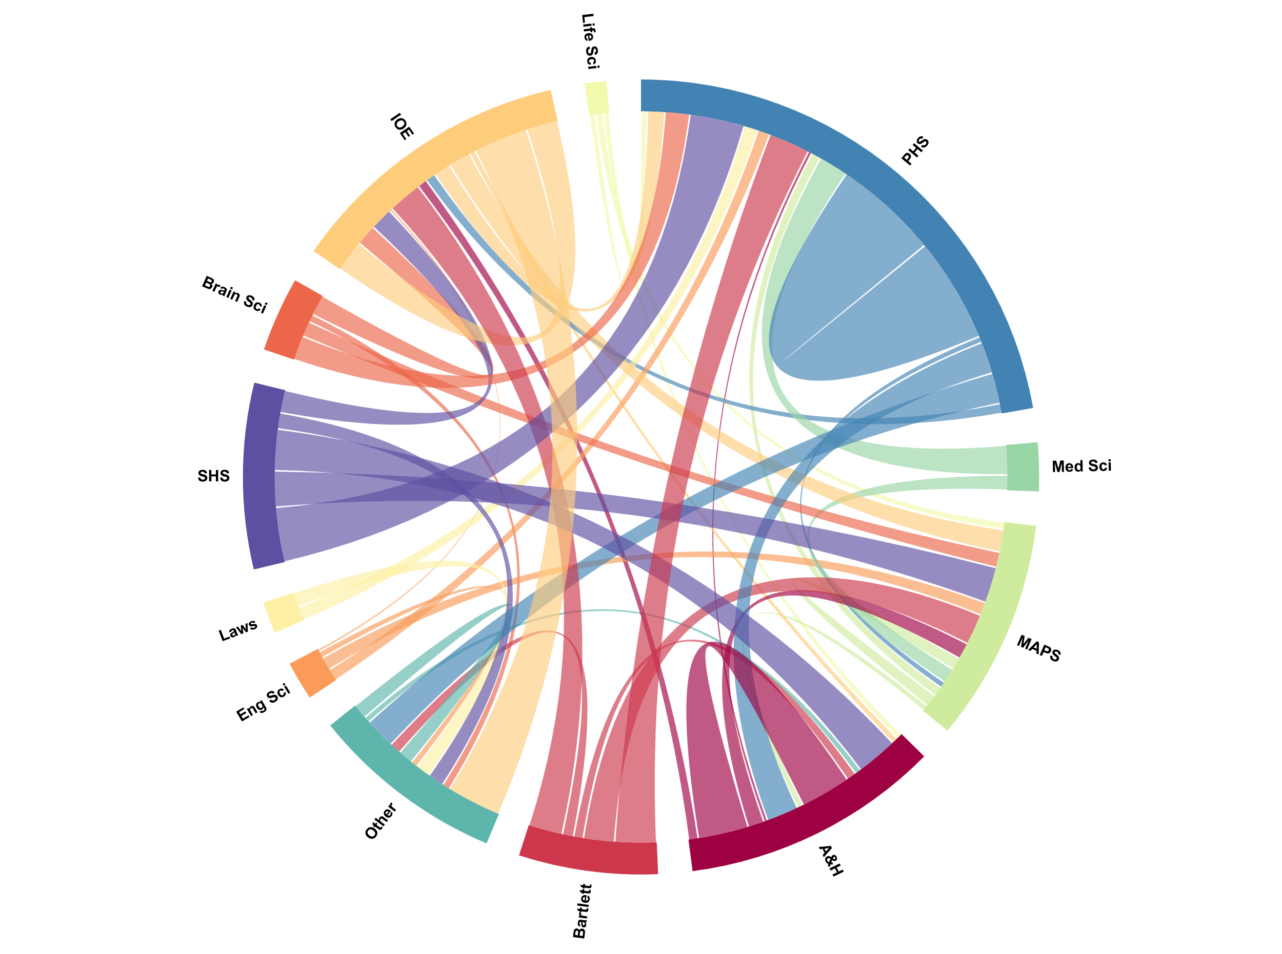
Knowledge Brokers in practice:
Institutional engagement
Established in 2008 to foster cross-disciplinary working within UCL
Institutionally central, flagship programme that now extends to support teaching, innovation and operations
A dedicated team of knowledge brokers working in partnership with academic leads
Funds, supports and facilitates challenge-led interdisciplinary approach
Notes:
An example of work to support within an institution.
In 2022 the programme underwent a transformation and has been recognized as a central priority of the UCL five yea strategic plan, as a critical delivery mechanism for challenge-led impact working, the programme has five new themes: Mental Health and Wellbeing, Climate Crisis, Data Empowered Societies, Inequalities and Intercultural Communication, stronger academic leaderships in the from of pro-vice provosts working together with an expanded PS team and significant institutional investment to
CLIP – challenge-led interdisciplinary programs – what has the GC achieved and where next for challenge-led working, drawing on international and other sector examples

Slide 9
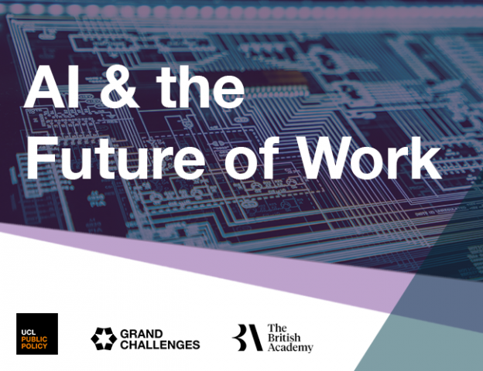
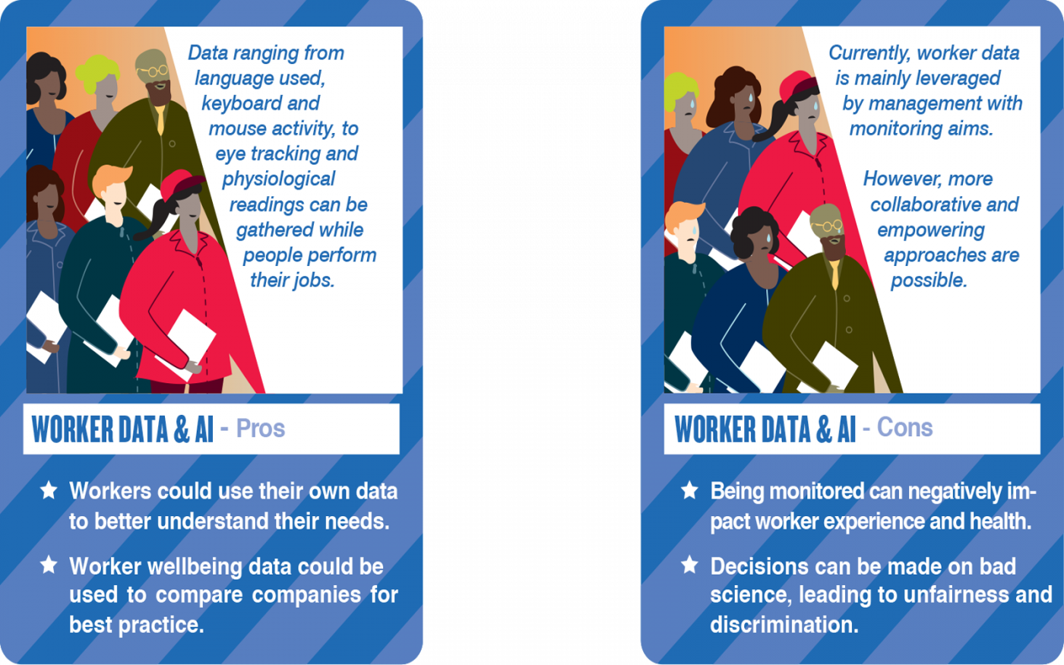
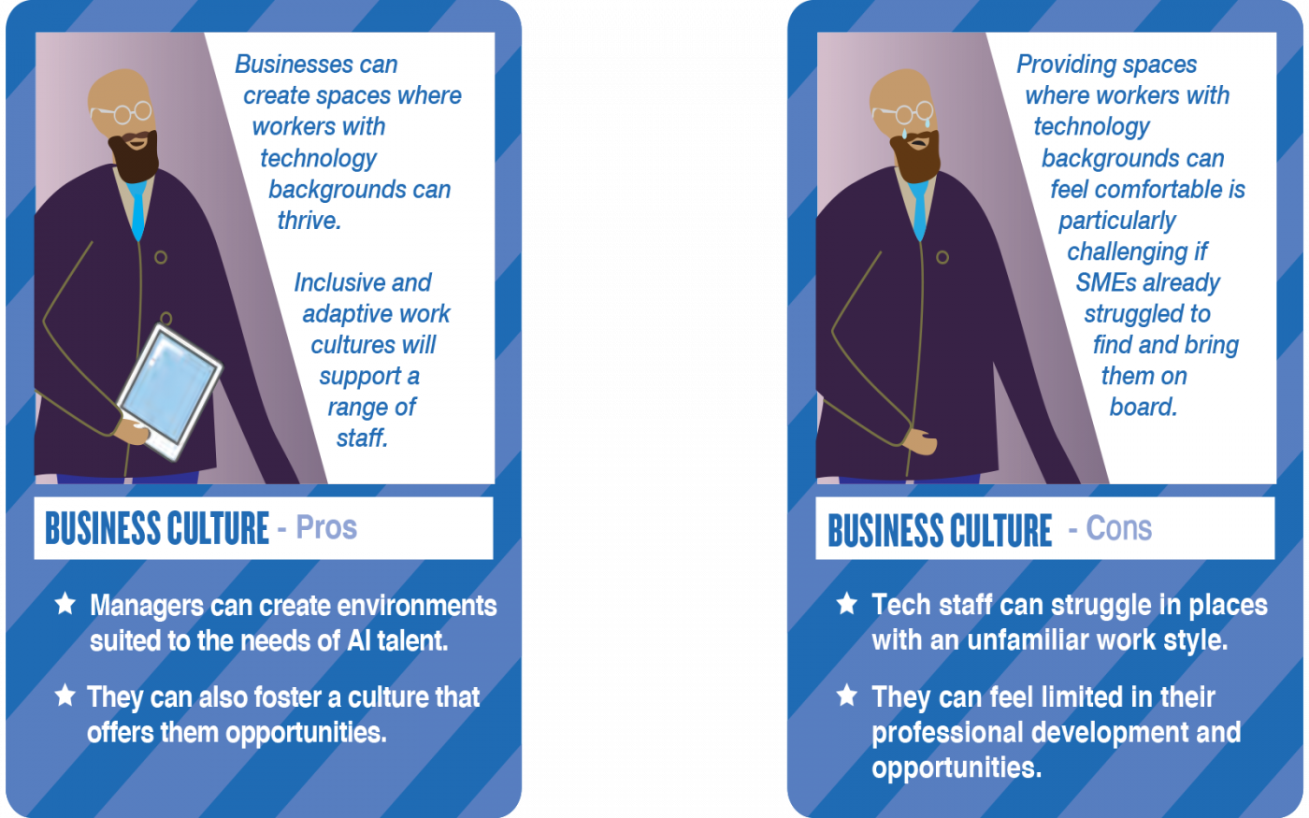
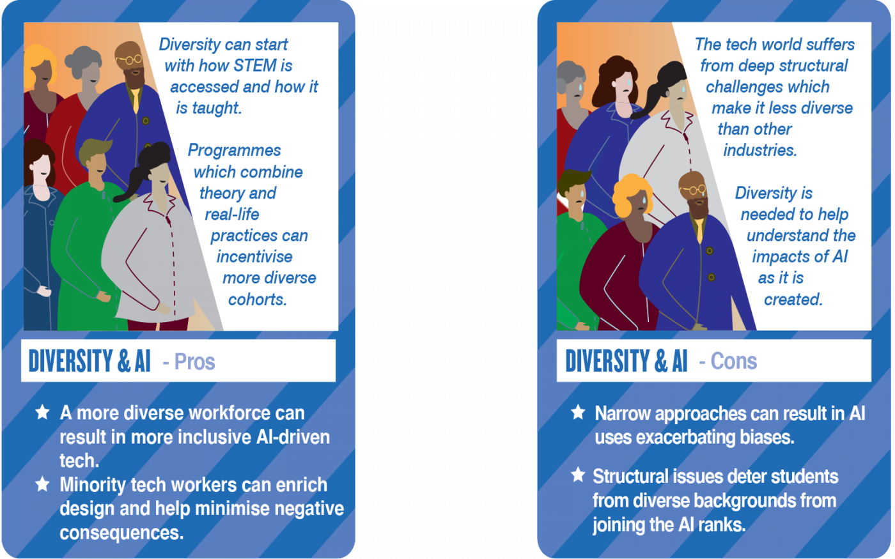
Knowledge Brokers in practice:
Impact projects
Two-year partnership project
Leveraged internal and external networks
Responding to policy and industry need
Convening, exploring, synthesising and recommending
Notes:
An example of the outreach of KB work.
This project was a multi-year engagement between the BA and UCL with partners and participation from research, government departments (OAI, DfE, DCMS) and industry (PwC, Tech UK),
started with horizon scanning, problem identification and opportunity for research input, it built engagement and collaboration between researchers and practitioners, synthesized research, discussion and consensions, provided actionable recommendations for policy, practice and research development, and undertook wider public engagement through a series of innovative outputs (playing cards and podcasts) – in short utailsing the full KB skillset through the course of the project
While the project is currently dorment the relationships continue to evolve creating new opportunities for engagement

Slide 10

Why do brokers matter?
Provides additionality
Greater acknowledgement and support will enhance
university impact
But…
Skills and competencies of these roles are still poorly understood
Career pathways and development opportunities are limited
Challenging and growing skill sets for individuals to maintain
Notes:
Focus on the we and the value of the role

Slide 11
Where next?
Teams of knowledge brokers?
A community of practice?
Thank you for listening
The invisible work of knowledge brokers, Cvitanovic and Cairney, Transforming Evidence
Hidden Talents: Core Competencies of Knowledge Mobilisers Working in Public; UCL Public Policy/CAPE
Boundary crossing research needs knowledge brokers, Welch, Morris and Paskins, WonkHE

